Slide 1
Globalization
The Role of Pharma Industries

Slide 2
Globalization
Globalization refers to the shift towards a more integrated and interdependent world economy.
Globalization helps in getting better access to different markets of entire world economy.
It throws up opportunities to various nations to maximize their economic output in product or services where they have competitive advantage over other.

Slide 3
Globalization
Globalization is a change which has come in a radical manner and has impacted the entire society.
The globalization will not be acceptable unless there is a broad agreement on objectives, processes and fundamental value buttressing civil society.
So there has to be few criteria of acceptability of globalization following which globalization will be successful.

Slide 4
Criteria of Acceptability of Globalization
Efficiency
Equity
Participation
Creativity
Risk adjustments
Human rights
Environmental protection

Slide 5
Efficiency
It is the major out come of capitalism which is aimed at getting optimum utilization of resources and directing them to the demands of consumers – individuals, organizations, government.
Efficiency is desired but not always sought
Rising avg. income can mask a wide dispersions of incomes, saying nothing about economic welfare or greater happiness.
Greater happiness isn’t necessarily produced by greater GNP, it depends upon how it is produced (treatment of workers and sound work environment)

Slide 6
Participation
Participation goes beyond the process of opportunity to gain income &wealth and the process of equity where the sections of society demand an appropriate role in the decision making process.
Not all of them may be accorded the same voice globally but means must be found to the make the role of each acceptable.. thus making it participative.

Slide 7
Equity
Efficiency speaks about optimum performance in production & distribution of goods & services, but doesn’t speak about the distribution of benefits in income & wealth.
Equity is all about bringing parity in the society
Past experience has shown that equality of material welfare can’t be a measure of equity without having an adverse effect on efficiency and growth.

Slide 8
Respect, Dignity, Human Rights
As globalization proceeds, the sovereign role of government will be mitigated, at least in setting the rules for international affairs. No country will accept being “lost” in the process-each must be respected if they are to be encouraged to play positive roles within world economy.
At individual level, there must be means of extending respect and treating others with dignity and deference in all phases of life and in death.
A greater harmonization of human rights is necessary.

Slide 9
What is transformation ?
Transformation is the change of believe system – a new way of looking at things, a different mind-set, a new formulation, a new design for life and living.
Transformation (both personal and institutional) have occurred throughout the history and are repeatedly occurring – more or less extensively or intensively.
Voluntary (guided) – take the form of ‘paradigm shifts’ in which events or knowledge accumulate until key relationships are seen quite differently : Copernican revolution.
Involuntary (evolution) transformation – process of change is more gradual – agricultural, commercial revolutions

Slide 10
Individual transformation
Of all the creature on earth, only Human beings can change their patterns.
By changing the inner attitudes of their minds, can change the outer aspects of their lives.
But transformation is not easy since it requires dedicated self-discipline. It involvers little sacrifice because the benefits are greater than what one gives up.

Slide 11
Individual transformation
The bad habits like :
The agony of trying to protect one’s Ego ( self-pride or vanity)
The unhappiness of anger and negative thoughts (envy and covetousness)
Temptations of over-indulgence(gluttony or licentiousness)
Worry and stress (frustration and depression)
The corruption of living off others (sloth and theft)

Slide 12
Individual transformation
Transformation of society is possible not only changing the mindsets of the individuals but also changing the mindset of institutions , organizations and government as well.

Slide 13
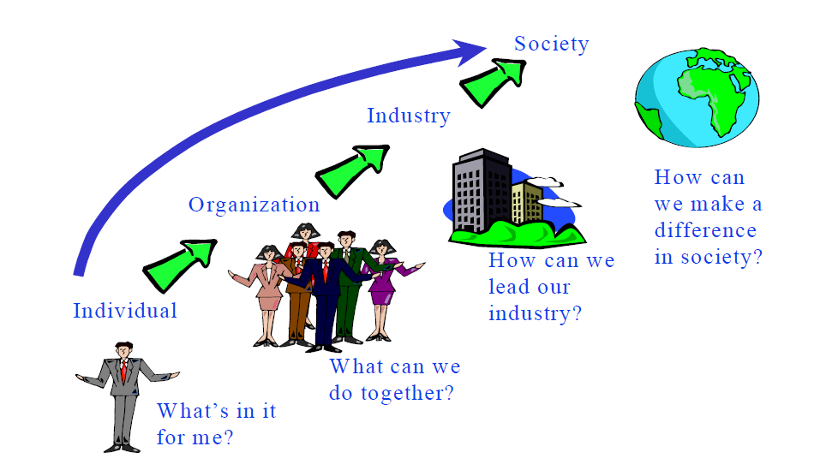

Slide 14
Creativity
Modern western cultures encourages the view : being human means to be creative – not simply living in response to nature.
Creativity for a nation means to be involved in scientific discovery and technological innovation according to their competitive advantage.
Opportunities of being creative in the economic arena are not spread evenly around the world.
The present conc. Of creativity in a few countries challenges the acceptability of globalization.

Slide 15
Risk Adjustments
With global integration of the economies, there will be even greater uncertainty and volatility in national economies than ever.
Not only will employment opportunity change, but also periods of unemployment are likely to be more frequent.
The richer nations should take more burden of risk as compared to the smaller courtiers.
Because once the risk pays off, the bigger developed country will be beneficiaries out of the shape.

Slide 16
Environment
Protection of environment has been given a raised profile by the UN, with most nations recognizing a threat through several areas of pollution & direct damage.

