Slide 1

Segmentation and Planning for change

Slide 2

Segmentation
The analytical goal is to measure consumer behaviour and place each person in a group (segment) that will minimise the behaviour between each member of the segment and maximise the variance between segments

Slide 3

Why do we need to segment?
Because people vary so much from other people – needs, motivations, decision processes, buying behaviour

Slide 4
Factors affecting size of segments
Affluence
Sophisticated consumer measurement and databases
Custom manufacturing
New forms of distribution

Slide 5

Micromarketing
The result of understanding and relating to an increasingly fragmented market place

Slide 6
Criteria for choosing market segments
Measurability
Accesibility
Substantiality
Congruity

Slide 7
Bases for segmentation
Geographic
Demographic
Psychographic
Behavioural – benefit, usage situation, extent of usage

Slide 8

Planning for change
Unless managements act, the more successful a company has been in the past, the more likely it is to fail in the future.
Because the basic psychological principle is that people tend to repeat behaviour for which they have been rewarded
Successful strategies must fit an environment that is constantly changing. Frequently, the future arrives before managers are willing to give up the present.

Slide 9
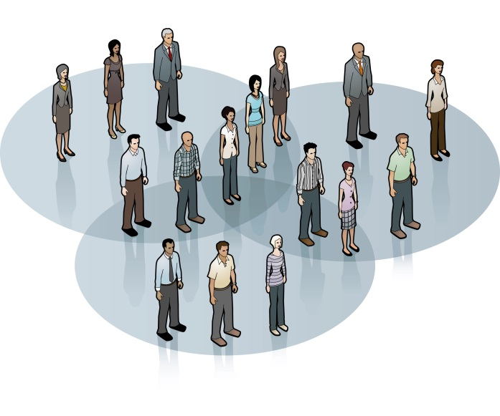
Consumer Analysis and Social Policy
Policy issues related to macro marketing and trends in consumer decisions
Behavioural/ Psychological economics.

Slide 10
3 M’s of profit Growth
More Markets
More Market Share
More Margins

Slide 11
Markets have 4 components
People and their needs
Ability to buy
Willingness to buy
Authority to buy

Slide 12
Customer Buying Career
Observing
Making requests
Making selections
Making assisted purchases
Making independent purchases

Slide 13
Behavioural consumer segmentation (Cohort analysis)
Baby boomers
Baby busters
Skippies
Yuppies
Muppies
Empty nesters
‘Young again’

Slide 14
Population Trends
Birth rates
Death rates
Fertility rates
Life expectancies
Order effects

Slide 15

Ethnocentricity
Focusing on one’s own way of doing things with very little sensitivity or interest in the ways of the world
Marketing practitioners need cultural empathy defined as the ability to understand the inner logic and coherence of other ways of life.

Slide 16
Porter’s 5 factors that characterize contemporary markets
Growing Similarity Of Countries
Fluid Global Capital Markets
Technological Restructuring
Integrating Role Of Technology
New Global Competitors

Slide 17
Cultural analysis of global markets
Cultural empathy
‘Think global, act local’
‘Think local, act global’
‘Glocalisation’
Therefore, standardisation is rarely possible.

Slide 18

Communication Problems
The diversity of markets and consumers also pose several communication challenges for marketers
Therefore visual language, pictures are mostly used for better universal understanding. Gestures and words can be misleading

Slide 19

Language problems
“ Please leave your values at the desk” – Paris Hotel
“ Drop your trousers here for best results” – Bangkok laundry
“Because of the impropriety of entertaining guests of the opposite sex in the bedroom, it is suggested that the lobby be used for the purpose” – Zurich hotel
“ The manager has personally passed all water served here” – Acapulco restaurant
“ Ladies are requested not to have children in the bar’ – Norway bar

Slide 20

Conceptual Equivalency
“ Come alive with Pepsi”
“ Come alive out of the grave” – Germany
“ Pepsi brings your ancestors back from the grave” - China

