Slide 1
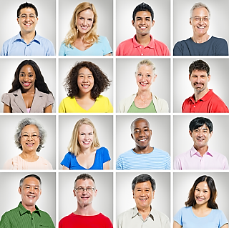
Individual Differences

Slide 2
Consumer Resources
Economic
Temporal
Cognitive

Slide 3
Economic Resources
Income
Disposable Income
GDP
Whose income?
Where is the income?
Consumer Confidence
Who has the buying power?
Targeting the up market, affluents
Targeting the down market

Slide 4

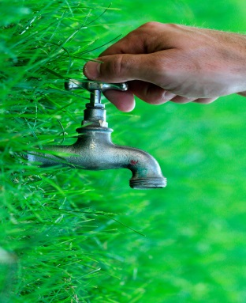
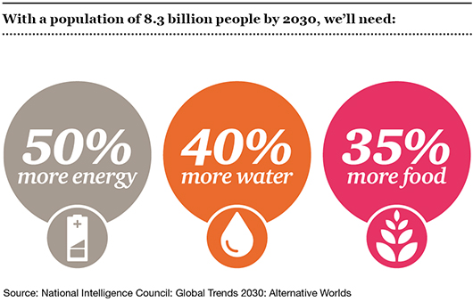
Temporal Resources
You have only 24 hours in a day
Scarcity creates value. For affluents, their chief concern is buying more time than products.
Work and leisure
Paid time, obligated time, discretionary time

Slide 5
Use Of Temporal Resources
Time using goods
Time saving goods
Polychronic use of time
Time prices
Time is precious- make best use of it

Slide 6
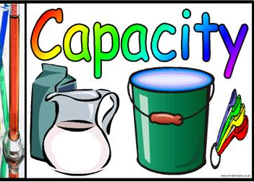

Cognitive Resources
The mental capacity available for undertaking various information processing activities
Capacity – chunks of information that can be handled by consumers at a time
Attention – allocation of cognitive capacity. Depends on direction and intensity

Slide 7

Knowledge
What do consumers know?
Companies are constantly sending out information to consumers with the hope that such information shall be accepted and acted upon
We need to know their product knowledge, their purchase knowledge, their price knowledge and their usage knowledge

Slide 8
Types Of Knowledge
Declarative
Procedural

Slide 9
Declarative knowledge
Episodic (When did you last buy?)
Semantic (General knowledge that is useful to all)

Slide 10

Procedural Knowledge
How to use such factual information

Slide 11
Product Knowledge
Awareness of the product category and brands within the the product category
Product terminology
Product attributes and features
Beliefs about the product category in general and specific brands

Slide 12

Purchase Knowledge
Where to buy?
When to buy?

Slide 13
Usage Knowledge
What is it for?
How to use?

Slide 14
Usage Knowledge
What is it for?
How to use?
Consumers without usage knowledge may be reluctant to buy or use the product. Inadequate usage knowledge may lead to consumer dissatisfaction because of improper usage or consumption

Slide 15
Price Knowledge
Marketers would be more motivated to hold prices down and respond to price cuts when they believe consumers are knowledgeable about the prices charged in the market.

Slide 16
Organisation of Knowledge
Associative network – memory consists of a series of nodes and links. A link between two nodes forms a belief or proposition.
Scripts- contains knowledge about temporal action sequences that occur during the event
Schema – these beliefs or propositions can be combined to create a higher order knowledge structure

Slide 17
Measurement of Knowledge
Objective
Subjective
Both these measures are important for the marketer to determine what additional inputs to be provided for the consumer to facilitate decision making.

Slide 18
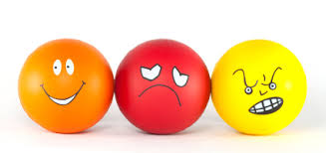
Attitudes
Consumer likes and dislikes
The barriers to success become smaller as a segment’s liking for a product grows larger

Slide 19
Attitudinal Behaviour
Feelings
Beliefs
Attitudes
Behavioural
Intention
Behaviour

Slide 20
Attitudes Are At Three Levels
Cognitive
Affective
Conative

Slide 21
Properties of Attitudes
Attitudes can vary along dimensions. This is called valence. It can be +ve, -ve or neutral.
Attitudes can differ in their extremity.
Attitudes can also differ in their resistance.
Attitudes can also have persistence.
Not all attitudes are held with the same degree of confidence.

Slide 22
The Affective Component Of Attitude
Speeds up information processing and cuts down search time
Recall of products with positive associations
Emotions can serve to activate a state of drive

Slide 23
Attitude Models
Fish-bien Model
Ideal Point Model

Slide 24
Fishbien Model
Probably the most popular model to explain consumer attitudes
i = n
A = ∑ b_{i}e_{i}
i = 0
Where A = attitude toward the object
b_{i} = strength of belief that the object has attribute i
e_{i} = evaluation of attribute i
n = no. of salient attributes

Slide 25
Ideal Point Model
i = n
A = ∑ W_{i} | I_{i} –X_{i} |
i = 0
Where, A = attitude towards brand
W_{i} = importance of attribute i
I_{i} = the ideal performance on attribute i
X_{i} = belief about brand’s actual performance
on attribute i
n = no. of salient attributes

Slide 26

Motivation
A person can be said to be motivated when his/her system is energised (aroused) , made active, and behaviour is directed towards a certain goal.

Slide 27

Dynamics of The Motivation Process
Need – activated or felt when there is a sufficient discrepancy between a desired or preferred state of being and the actual state.
Drive – as this discrepancy increases, the outcome is activation of a condition of arousal

Slide 28
Self Concept
Real self
Ideal self
Self in context
Extended self

Slide 29
Self Expression
Transcedence
Self-monitoring
Fantasy
Self gift-giving

Slide 30
Transcedence
Our possessions are a reflection of the our self-concept. This allows us to transcend our self into our possessions

Slide 31
Self Monitoring
Concern for social appropriateness in behaviour
Attention to social comparison as cues for appropriate self expression
Ability to modify self presentation and expression across situations

Slide 32
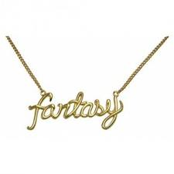

Fantasy
Comparison with real self and ideal self

Slide 33

Self Gift - Giving
Bolsters self esteem through an indulgence justified by deserving behaviour

Slide 34
Some Pointers for Marketing Strategy
Interpret research with caution
Be alert to the possibility of motivational conflict
Be prepared to provide socially acceptable reasons for choice
Exercise caution when marketing cross-culturally

Slide 35

Personality
Consistent responses to environmental stimuli

Slide 36

3 Approaches to Studying Personality
Psychonalytic Theory
Soco-psychological Theory
Trait Factor theory

Slide 37

Psychoanalytical theory
This is the dynamic interaction of the elements of the human personality system-id, ego and superego, results in unconscious motivationsthat are manifested in human behaviour

Slide 38

Socio-Psychological Theory
This recognises the interdependence between individual and society. Social variables rather than biological instincts are determinants in shaping personality. Behaviour is directed to meet those needs

Slide 39
Trait Factor Theory
An individual’s personality is composed of definite predispositional attributes called traits.
A trait is any distinguishable, relatively enduring way in which individuals differ from one another.

Slide 40
Research has shown so far that consumer selection of products based on personality has been a poor predictor, only slightly better than by chance
Whereas, brand personality has been a better predictor and influence in making consumer selections

Slide 41
Personality can help explain how consumers would behave at various stages of the decision making process
Therefore, learning styles, need for cognition, risk taking, thrill seeking and self-monitoring are better indicators of personality and what impact it would have on behaviour

Slide 42
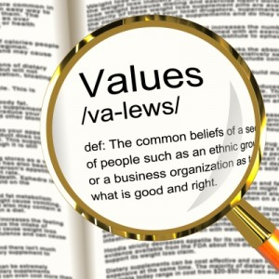
Personal Values
Values provide another explanation of why consumers vary in their decision making. Values express the goals that motivate people and appropriate ways to achieve those goals

Slide 43
Values can be
Personal – ‘Normal’ behaviour for an individual
Social – ‘Normal’ behaviour of society
A lot of our personal values can get impacted by social values.

