Slide 1
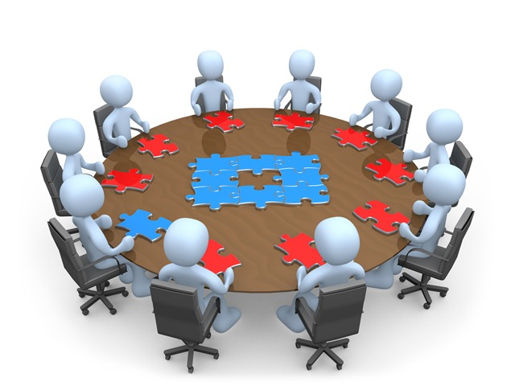
Product Management

Slide 2
What is a product?
A product is any offering by a company to a market that serves to satisfy customer needs and wants.
It can be an object, service, idea,etc.

Slide 3
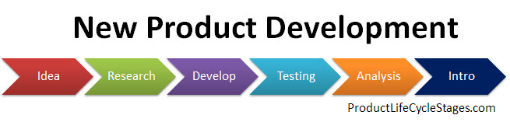
New Product Development
Most new product development is an improvement on existing products
Less than 10% of new products are totally new concepts.

Slide 4

Success rate of new products
The success rate of new products is very low – less than 2%. ‘You have to kiss a lot of frogs to find a prince.”
Product obsolescence is rapid with improvements in technology
Shorter PLCs

Slide 5
Product Development Stages
Idea generation
Idea screening
Concept development and testing
Concept testing
Conjoint analysis – to find out the best valued attributes by consumers

Slide 6
Business analysis
The most customer appealing offer is not always the most profitable to make
Estimate on costs, sales volumes,pricing and profit levels are made to find out the optimal price – volume mix.
Breakeven and paybacks
Discounted cash flow projections

Slide 7
Market testing
Test markets
Test periods
What information to gather?
What action to take?

Slide 8
Commercialization
When? (Timing)
Where? (Which geographical markets)
To whom? (Target markets)
How? (Introductory Marketing strategy)

Slide 9
Product Levels
Customer value Hierarchy:
Core benefit
Basic product
Expected product
Augmented product
Potential product

Slide 10

Customer Delight
When you exceed customer expectations

Slide 11
Product Hierarchy
Need
Product family
Product class
Product Line
Product type
Brand
Item

Slide 12
Product classification
Durable
Non – durable
Services

Slide 13
Consumer Goods Classification
Convenience goods
Shopping goods
Specialty goods
Unsought goods

Slide 14
Industrial goods classification
Materials and Parts
Capital items
Supplies and business services
- raw materials
- manufactured materials and parts

Slide 15
Product Mix
The assortment of products that a company offers to a market
Width – how many different product lines?
Length – the number of items in the product line
Depth – The no. of variants offered in a product line
Consistency – how closely the product lines are related in usage

Slide 16
Product Line decisions
Product rationalization
Market rationalization
Product line length
too long – when profits increase by dropping a product in the line
too short – when profits increase by adding products to the product line
Line pruning – capacity restrictions to decide

Slide 17

Packaging
Includes the activities of designing and producing the container for a product
Packaging is done at three levels
- Primary
- Secondary
- Shipping

Slide 18
Packaging as a marketing tool
Self service
Consumer affluence
Company and brand image
innovation

Slide 19
Designing packaging
Packaging concepts
Technical specifications
Engineering tests
Visual tests
Dealer tests
Consumer tests
Packaging innovations
Environmental considerations

Slide 20
Labels
Identification
Grade classification
Description of product
Manufacturer identity
Date of mfg., batch no.
Instructions for use
Promotion

Slide 21
Labels as a marketing tool
Labels need to change with time or packaging changes to give it a contemporary and fresh look

