Slide 1

Pricing

Slide 2
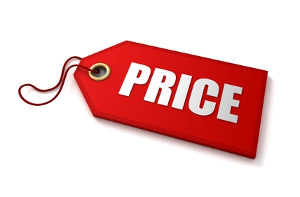
price is all around us. you pay rent for your apartment, tuition for your education, and a fee to your dentist or physician. the airline, railways, taxi and bus companies charge you a fare; the local utilities call their price a rate; and the local bank charges you interest for the money you borrow. you have to pay a toll when you drive on the bridge and the insurance company charges you a premium. the guest lecturer is paid an honorarium and the government official takes a bribe to pass a file which was his job anyway. your lawyer asks for a retainer and you are paid a salary, while the salesman has to make do with a commission and the worker is paid wages.

Slide 3

Price = Cost + Profit

Slide 4
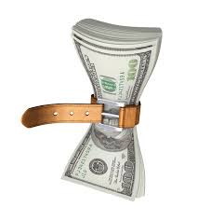
Price brings in the revenues
This is the only element in the marketing mix that brings in the revenues. All the rest are costs
Price communicates the value positioning of the product.

Slide 5
Pricing policy
Selecting the pricing objective
Determining demand
Estimating costs
Analysing competitors – costs, prices, offers
Selecting a pricing method
Selecting the final price

Slide 6
The pricing objective
Survival
Maximum current profit
Maximum market share – penetration pricing
Maximum market skimming
Product quality leadership

Slide 7
Determining Demand
Price sensitivity
Price elasticity of demand

Slide 8
What influences price sensitivity?
Shared cost
Sunk investment
Price – quality
Inventory effect
Unique value effect
Substitute awareness
Difficult comparision
End benefit
Total expenditure

Slide 9

What is price elasticity?
This determines the changes in demand with unit change in price
If there is little or no change in demand, it is said to be price inelastic.
If there is significant change in demand, then it is said to be price elastic.

Slide 10
Demand is likely to be less elastic when
There are few or no substitutes
Buyers readily do not notice the higher price
Buyers are slow to change their buying habits
Buyers think that the higher prices are justified

Slide 11
Price Quality Strategies
Super value | High value | Premium
Good value | Medium value | Overcharging
Economy | False economy | Rip off
Quality
Price

Slide 12
Estimating costs
Fixed costs
Variable costs
Learning curve
Activity based costing
Target costing

Slide 13
Pricing methods
Markup pricing
Target return pricing
Perceived value pricing
Value pricing
Going rate pricing
Sealed bid pricing
Group Pricing
Gain/loss risk sharing pricing

Slide 14


Psychological pricing
It is used to lessen the impact of the actual pricing in the consumers mind
It is used as a surrogate to indicate the product quality or esteem

Slide 15
Geographical Pricing
Different pricing at different locations
Could be in terms of barter, countertrade and foreign currency

Slide 16
Discounts and Allowances
Early payment
Off – season
Bulk purchase
Retail discount
Cash discount

Slide 17
Promotional Pricing
Loss leader pricing
Special event pricing
Cash rebate
Low interest financing
Longer payment terms
Warranties and service contracts
Psychological discounting

Slide 18
Discriminatory Pricing
Customer segment
Product form
Image pricing
Location pricing
Time pricing

Slide 19
Preconditions
Market must be segmentable
The lower price segment should not be able to resell the product to the higher price segment
The competitors must not be able to undersell the firm in the higher price segment
Should not breed customer resentment and ill will
Price discrimination should not be illegal

Slide 20
Product Mix Pricing
Product line pricing
Optional feature pricing
Captive product pricing
Two part pricing
Byproduct pricing
Product bundling pricing

Slide 21
Indirect price increases
Shrinking pack size for same price
Substituting less expensive raw materials
Reducing product features
Removing product services
Using less expensive packaging material
Reducing the no.of packs and sizes offered
Creating new economy brands

Slide 22
Initiating Price cuts
Excess plant capacity
Competition
Aggressive pricing

Slide 23
Initiating price increases
When demand exceeds supply
When costs go up
Govt. policies
Reduce/remove discounts and rebates

Slide 24
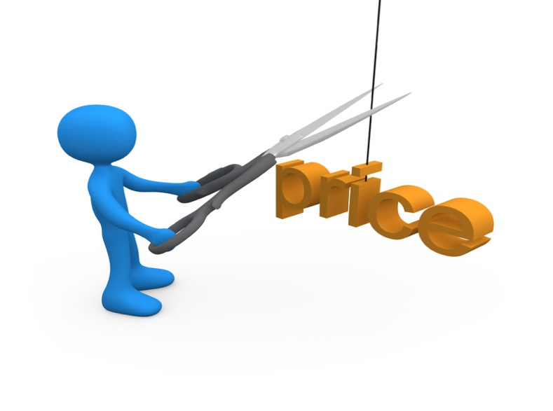

Reaction to price changes
Customer reaction
Competitor reaction

Slide 25
Responding to competitor price changes
Maintain price
Maintain price and add value
Reduce price
Increase price and quality
Launch a low price fighter

