Slide 1
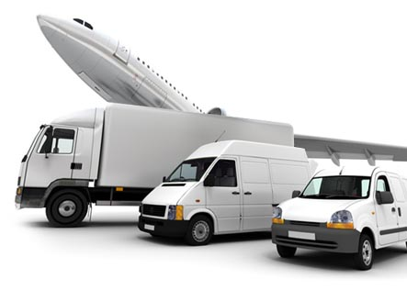
Distribution and Logistics

Slide 2
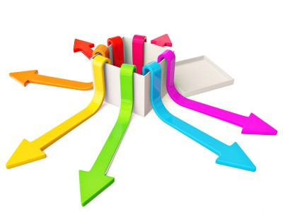
What is a Marketing Channel?
This is a set of interdependent organizations involved in the process of making a product or service available for use or consumption

Slide 3

Intermediaries involved in this process
Agents – acting on behalf of buyer or seller but do not take title of the goods
Facilitators – transporters, C&Fs, banks, ad agencies

Slide 4
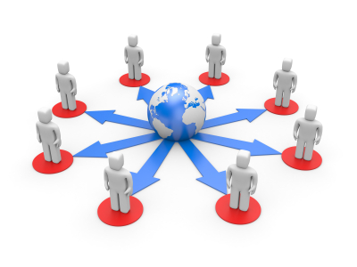
Advantages of a distribution system
Key external resource
Takes years to build
Significant corporate commitment to a large no. of firms
Commitment to a set of policies that nourishes long term relationships

Slide 5
Why would a manufacturer not like to do his own distribution?
Lacks the financial resources to do direct marketing
Cannot have the infrastructure to make the product widely available and near the customer
Trading profits could be less than manufacturing profits

Slide 6
Manufacturers typically produce a large quantity of a limited variety of goods
Consumers usually desire a small quantity of a wide variety of goods

Slide 7
If all manufacturers tried to reach all consumers
M1
C1
M2
C2
M3
C3

Slide 8
If they tried to go through an intermediary
M1
C1
M2
D1
C2
C3
M3

Slide 9
Channel functions
Gathers information on customers, competitors and other external market data
Develop and disseminate persuasive communication to stimulate purchases
Agreement on price and other terms so that transfer of ownership can be effected
Placing orders with manufacturers

Slide 10
Channel functions (cont’d)
Acquire funds to finance inventories and credit in the market
Assume responsibility of all risks of the trade
Successive storage and movement of products
Helps buyers in getting their payments through with the banks
Oversee actual transfer of ownership

Slide 11
Channels can be
Forward
Backward

Slide 12
Channel Alternatives
Types of available business intermediaries
No. of intermediaries needed
Terms and responsibilities of each channel member

Slide 13
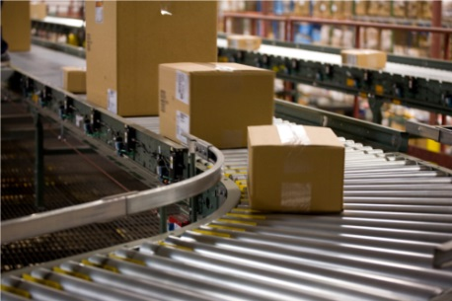
Types of intermediaries
Distributors
Wholesalers
Retailers
Department stores

Slide 14
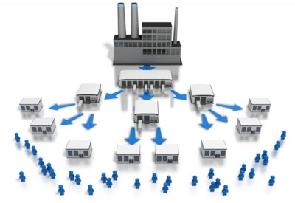
What kind of distribution?
Exclusive
Selective
Intensive

Slide 15
Terms and Responsibilities
Rights and responsibilities are drawn up
Territorial rights are fixed
Pricing policies and conditions of sales are fixed

Slide 16
Evaluating alternatives
Economic
Control
Adaptive

Slide 17
Channel management
Selecting channel members
Training channel members
Motivating channel members

Slide 18
Managing channel members
Coercive
Reward
Legitimate
Expert
Referent

Slide 19
Channel modification
With time channels need to change along with product as it get older in the PLC
Introduction – boutiques,company showrooms
Growth – chain stores, departmental stores
Maturity – Mass merchandisers
Decline – ‘sales stores’, discount stores

Slide 20
Adding channels
Advantages
Increased market coverage
Lower channel costs
More customised selling
Disadvantages
Increases selling costs
Increases channel control
Breeds channel conflict

Slide 21
Roles of individual channel member firms
Insiders
Strivers
Complementers
Transients
Outside innovators

Slide 22
Channel conflict
Interest of different business interests do not necessarily coincide
Conflicts can occur at various levels:
Vertical
Horizontal
Multichannel

Slide 23
Conflict causes
Goal incompatibility
Differences in perception
Great dependence

Slide 24
Legal and ethical issues
Exclusive dealings
Exclusive territories
Tying agreements
Dealer rights

Slide 25
Retailing
Includes all activities involved in selling goods or services directly to final consumers.

Slide 26
Types of Retailers
Self – service – discount stores (no assistance)
Self – selection – dept. store (assistance is available if required)
Limited service – counter sales men are there
Full service – Co. showrooms. Salesmen are available to explain, demonstrate, give technical help and promote the products

Slide 27
The target market will define
Assortment of goods to be stocked
Store atmospherics and services
Pricing decision
Promotion decision
Place decision

Slide 28
Retail sales effectiveness
No. of people passing by on an average day
% who enter the store (footfalls)
%entering who buy
Amount spent per buyer

Slide 29
Store Brands
With the increase in size and buying strength of retailers, companies are forced to now customize products for them. These are known as store brands. They may compete at the store with the company’s own brands.

Slide 30
What is wholesaling?
It includes all activities involved in selling goods and services for resale or business use. They are the intermediaries between manufacturers and retailers.

Slide 31
Characteristics of wholesalers
Less attention to promotion, atmosphere and location
Transactions are usually large and cover a wider geographical area
Could have different tax implications, regulations, etc. because of its status as a wholesaler

Slide 32
Functions of a wholesaler
Financing
Risk bearing
Market information
Management services and counselling
Selling and promoting
Buying and assortment building
Bulk breaking
Warehousing
Transportation

Slide 33
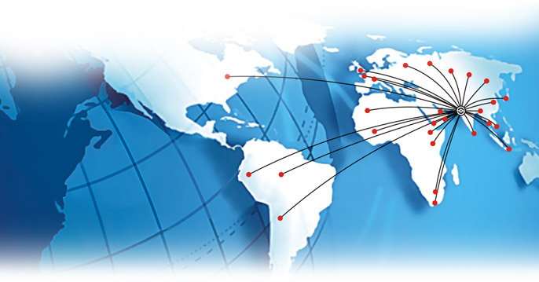
Market Logistics
Involves the planning, implementing and controlling the physical flows of materials and final goods from point of origin to points of use to meet customer requirements at a profit.
It involves materials management, distribution systems and IT systems interlinked with one another

Slide 34
Logistics objective
Getting the right goods at the right place at the right time for the least cost
‘the last frontier for cost economies’.

Slide 35
Market Logistics decisions
Order processing
Warehousing
Inventory
Transportation

Slide 36
Inventory vs Service levels
100%
Service level
cost
Reorder point should balance
the risks of stockouts against
costs of overstocking
Company needs to balance ordering costs vs
inventory carrying costs
inventory

Slide 37
Logistics vs. Sales
Objectives can be conflicting
Conflict resolution can be done by trading off costs vis -a- vis customer satisfaction

