Slide 1

Marketing Communications

Slide 2
The Communications Process
Message
Media
Sender
Encoding
Decoding
Receiver
Noise
Feedback
Response

Slide 3
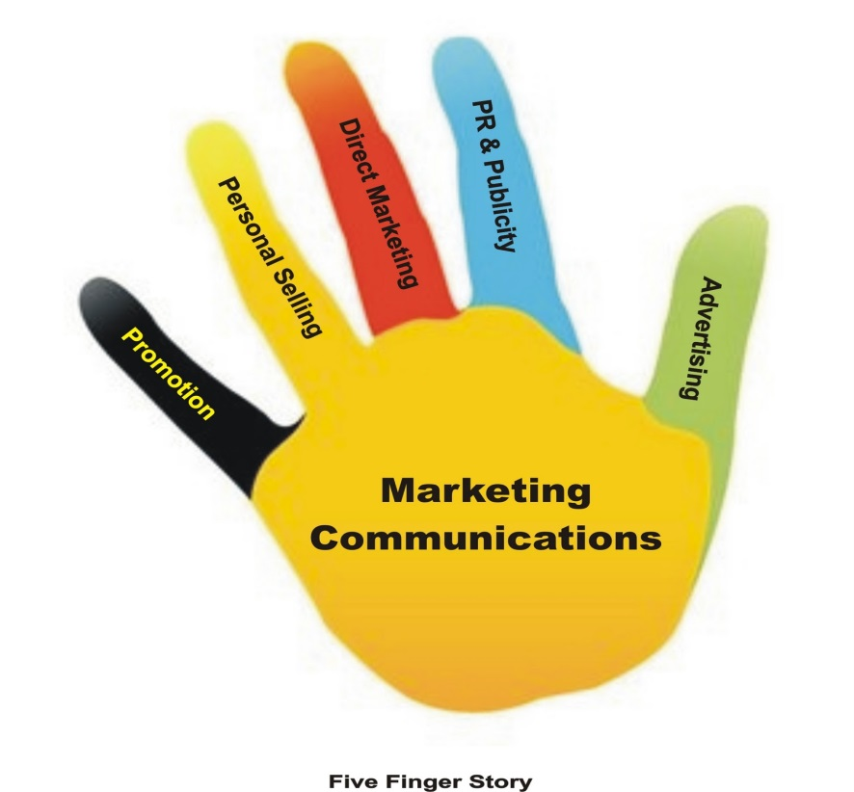
Marketing Communications mix
Advertising
Direct marketing
Sales Promotion
Personal selling
PR and Publicity
Each of these has its own uses and limitations and hence a judicious mix is employed by most companies.

Slide 4
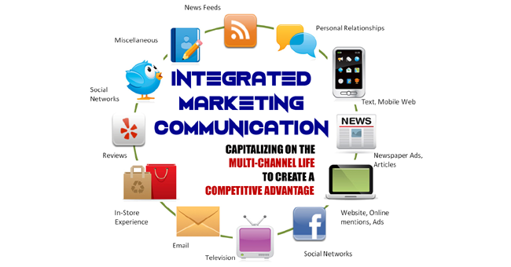
Integrated Marketing Communications
This brings about synergy and better use of communication funds
Balancing the ‘push’ and ‘pull’ strategies
Improves the company’s ability to reach the right consumer at the right place at the right time with the right message.

Slide 5
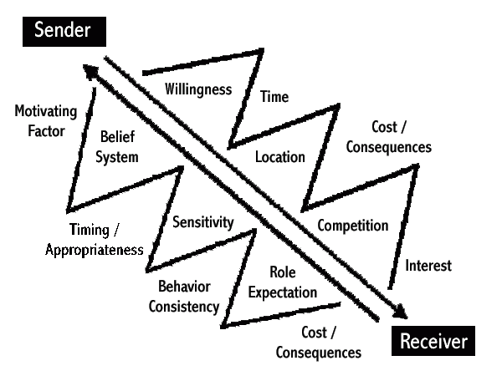
Distortions in Communication
Selective attention
Selective distortion
Selective retention

Slide 6
Factors influencing effectiveness of communications
When the recipient’s source of communication is single
When message is in line with recipients opinions and beliefs
When issues are unfamiliar or peripheral issues
When the source is an expert, of high status, likeable, has power and can be identified with
When social context or reference group will mediate the communication and influence acceptability

Slide 7
AIDA Model
Attention
Interest
Desire
Action

Slide 8
Message
Content
Structure
Format
Source

Slide 9
Message Source
Source credibility
Endorser
Depending on the attitudes of the consumer, the communication will either get a +ve , neutral or -ve response depending on what attitudes the consumer has of the endorser

Slide 10
Message Format
The message has to be considered depending on which media is going to be used – eg. Layouts, props, models, music, voice, etc.

Slide 11
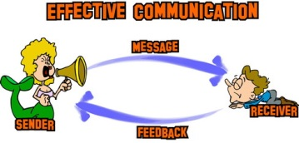
Communication channels
Personal – Direct selling,WOM
Non Personal – media, atmosphere, events

Slide 12

What is Advertising?
It is any paid form of non – personal presentation and promotion of ideas, goods, services by an identified sponsor.

Slide 13
The 5 Ms of Advertising
Mission – objectives
Money – budgets
Message – communication
Media – what vehicles?
Measurement - evaluation

Slide 14
Advertising objectives
Informative
Persuasive
Comparative
Reminder (reinforcement)

Slide 15
How much to spend?
‘Half my advertising is wasted, but the trouble is I do not know which half
- John Wanamaker

Slide 16
How much to spend?
Depends on the product:
What stage in the PLC
Market share and the consumer base
Competition and clutter
Ad frequency
Product substitutability

Slide 17
Advertising Budgeting
Historical
Competitive Parity
All-you-can-afford
Objective and task

Slide 18

Media selection
The most cost effective media mix to ensure achievement of the advertising goal.

Slide 19
How should you select media?
Reach
Frequency
Impact

Slide 20

Reach
No. of persons exposed to a particular media schedule at least once during a specified time period

Slide 21

Frequency
No. of times within the specified period that a person is exposed to that message

Slide 22

Impact
Qualitative value of an exposure through a given medium
GRP (Gross rating points) = R * F
Wt. GRP = R * F * I

Slide 23
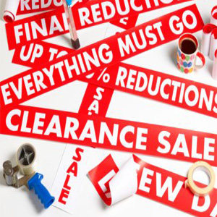
Sales Promotion
Whereas advertising gives a reason to buy, SP gives an incentive to buy

Slide 24
Advantages of SP
Induces trials
To reward loyal customers
To induce stocking by the trade
Adjust to short term variations in trade
Liquidating inventories
Preempting competition

Slide 25
Disadvantages of SP
With too many promotion schemes ‘promotion clutter’ confuses consumers
Attracts ‘brand switchers’ and ‘deal prone’ customers
Dilutes brand equity
Preponement of purchases
Lowers margins
Expensive and wasteful, when not handled properly

Slide 26
Types of SP
Trade
Consumer

Slide 27

Public Relations
Involves a variety of programmes to promote or protect a company’s image or products

Slide 28
Functions of PR
Media relations
Product publicity
Corporate communications
Lobbying
Counseling

Slide 29
MPR
Assisting in new product launches
Assisting in repositioning of product
Building interest in product category
Influencing specific target groups
Defending products that have encountered public problems
Building corporate image that rubs off on the products

Slide 30
Advantages of MPR
Building awareness
Building credibility
Stimulate sales force and dealers
Holds down promotion costs

Slide 31
The bottom line
PR is difficult to measure, but if consistently pursued with, it can have tremendous synergy with advertising and sales promotion, thereby reducing overall promotion costs

