Slide 1

Brand Management
BRAND
MANAGEMENT

Slide 2
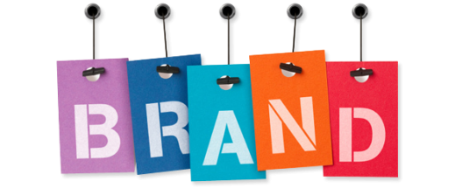
What is a brand?
A brand is a name, term, sign, symbol, design or a combination of the above to identify the goods or service of a seller and differentiate it from the rest of the competitors
It is a bundle of values and attributes that define the value you deliver to people through the entire customer experience and the unique way of doing business that forms the basis of your company’s relationships with all of its stakeholders

Slide 3
When you cannot do this
The Product Is A Commodity

Slide 4
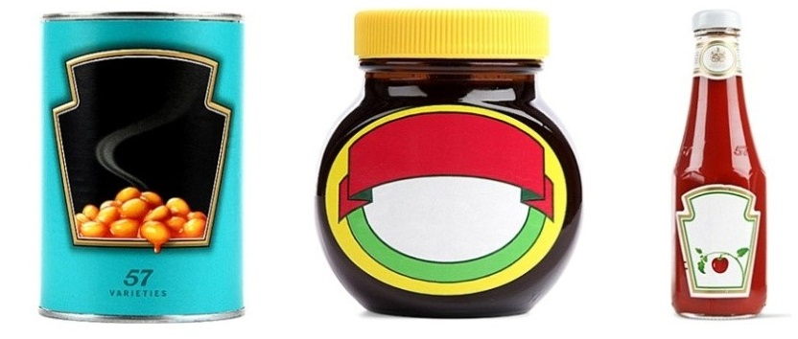

A brand comprises of
Tangible attributes
Intangible attributes

Slide 5
Tangibles
Product
Packaging
Labelling
Attributes
Functional benefits

Slide 6
Intangibles
Quality
Emotional benefits
Values
Culture
Image

Slide 7
Brand Identity
It is the marketer’s promise to give a set of features, benefits and services consistently

Slide 8
Advantages of Branding
Easy for sellers to track down problems and process orders
Provide legal protection of unique product features
Gives an opportunity to attract a set of loyal and profitable customers
Helps to give a product at different segments having separate bundle of benefits
Helps build corporate image
Minimises damage to company if brand fails

Slide 9
Brand Building
Involves all the activities that are necessary to nurture a brand into a healthy cash flow stream after launch

Slide 10
What kind of activities?
Product development
Packaging
Advertising
Promotion
Sales and distribution

Slide 11
Brand Equity
When a commodity becomes a brand, it is said to have equity

Slide 12
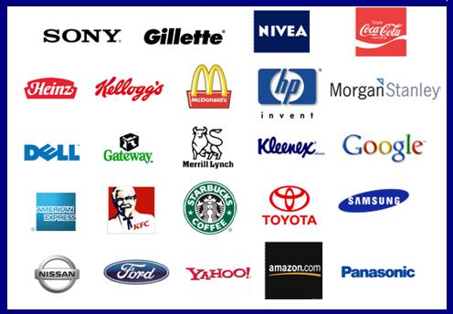
What is brand equity?
The premium it can command in the market
Difference between the perceived value and the intrinsic value

Slide 13
What happens when brands have high equity?
The company can have more leverage with the trade
The company can charge a premium on their product
The company can have more brand extensions
The company can have some defense against price competition

Slide 14
Brand Loyalty Pyramid
Committed Buyer
Likes The Brand. Considers
It A Friend
Satisfied Buyer. Would
Incur Costs To Switch
Satisfied Buyer/No Reason To Change
Switchers/Price Sensitive

Slide 15
Brand Parity
Consumers buy from a set of acceptable preferred brands

Slide 16
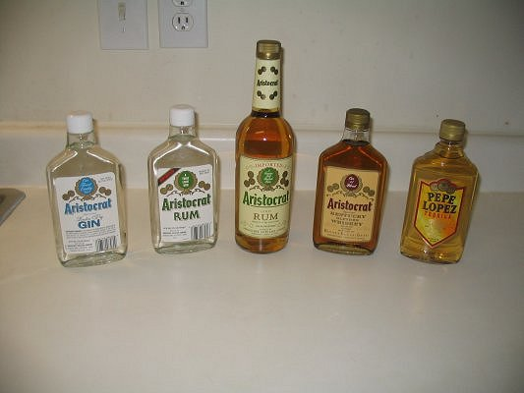
Umbrella Branding
Products from different categories under one brand
Dangerous to the brand if the principal brand fails
Sometimes the company name is prefixed to the brand. In such cases the company name gives it legitimacy and the product name individualizes it.

Slide 17

How are brand names chosen?
What does the brand name mean?
What associations/ performance/ expectations does it evoke?
What degree of preference does it create?

Slide 18
A brand name should indicate
Product benefits
Product category
Product quality
Names easy to remember, recognise, pronounce
Distinctiveness
Should not indicate poor meanings in other markets or languages

Slide 19
Brand Strategy
Line Extension – Existing brand extended to new offerings in the same product category
Brand Extension – Existing brand name extended to new product categories
Multi Brands – Different brands in the same product category
New Brand – New offering in any product category
Cobrands – Brands bearing two or more well known brand names

Slide 20
Brand Repositioning
This may be required after a few years to face new competition and changing customer preferences

