Slide 1
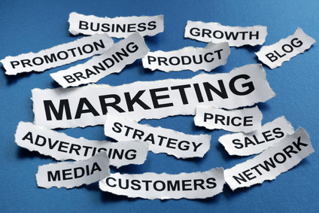
Introduction To Marketing

Slide 2
What is Marketing?
Social definition
A societal process by which individuals and groups obtain what they need and want through creating, offering and freely exchanging products and services of value with others

Slide 3
What is Marketing?
It is an organizational function and a set of processes for creating, communicating and delivering value to customers and for managing customer relationships in ways that benefit the organization and its stakeholders - AMA

Slide 4
“The aim of marketing is to make selling superfluous. It is to know and understand the consumer so well that the product/service fits her and sells itself. Ideally, marketing should result in a customer ready to buy. All that should be needed then is to make the product or service available.”
– Peter Drucker

Slide 5
Concepts Under Which Firms Conduct Marketing Activities
Production Concept
Product Concept
Selling Concept
Marketing Concept
Holistic Concept

Slide 6
Holistic Marketing
Holistic Marketing
Internal Marketing
Integrated Marketing
Relationship Marketing
Performance Marketing

Slide 7
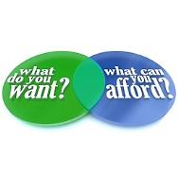
Needs and Wants
Needs are basic human requirements
Wants are needs directed to specific objects/services that might satisfy the need

Slide 8

Customer Needs
Stated needs
Real needs
Unstated needs
Delight needs
Secret Needs

Slide 9
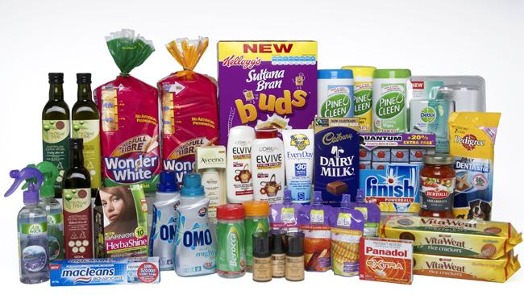
Product
A product is any offering catered to satisfy needs and wants.
A brand is when the product is from a known source.

Slide 10
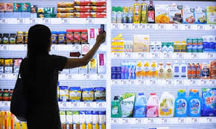
Demand
This is the wants for specific products backed by an ability to pay.

Slide 11
Market
A place where buyer and seller meet and carry out transactions
Geographical
Demographic
Product category
Customer group
Consumer
Business
Global

Slide 12

Target Market
Very rarely does a product cater to the entire market. Most products are designed to cater to a group of customers who specifically want such a product. This group of customers is the target market which is a slice of the total market. We say it is the market segment.

Slide 13
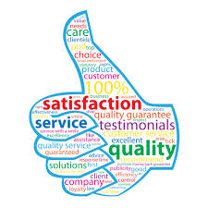
Value and Satisfaction
Value = Benefits/Costs
Benefits = Functional Benefits + Emotional benefits
Costs = Monetary costs + Time + Energy +
Psychic costs

Slide 14
Transaction and Transfer
A transaction is an exchange between two things of value on agreed conditions and a time and place of agreement.
A transfer is a one way exchange without receiving anything in return.

Slide 15
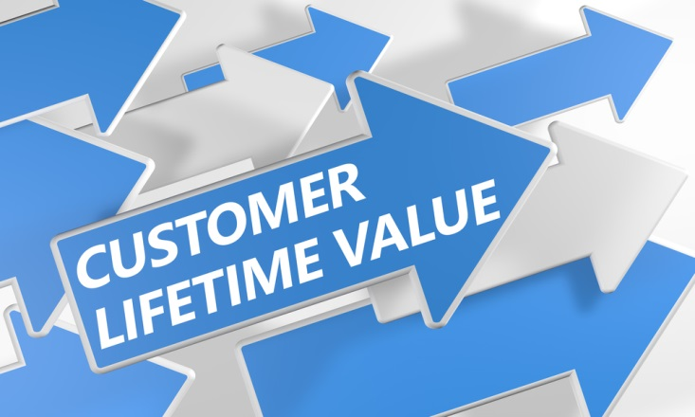
Customer Lifetime Value
It is the present value of the future discounted profits to be made on a customer’s life time purchases

Slide 16
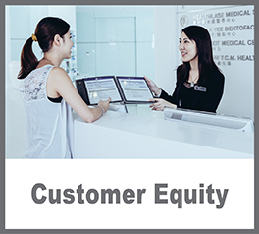
Customer Equity
The total discounted lifetimes values of all the firm’s customers

Slide 17

Relationship Marketing
Building long term mutually satisfying relations with customers, suppliers, distributors in order to retain their long term preference and business

Slide 18
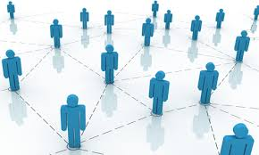
Marketing Network
A marketing network is the relationships built with its stakeholders. Effective relationships make up an effective and strong network.

Slide 19
Marketing Channels
Marketing channels are used to reach the target segment.
Communication channels
eg. Advertising, telephone enquiry system
Distribution channels – trade, direct sales

Slide 20
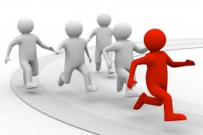
Competition
Potential and rival substitutes and offerings a buyer might consider.
Competition can be viewed in various perspectives – brand, industry, form, generic

Slide 21
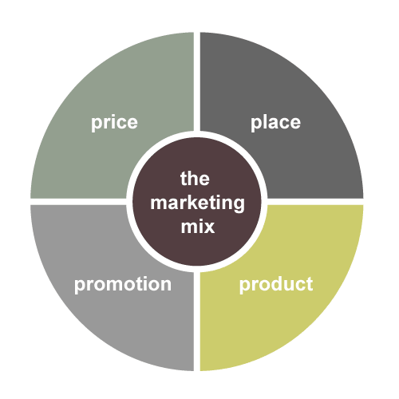
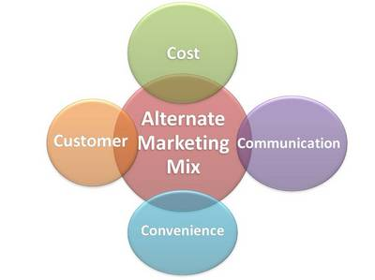
Marketing Mix
It is the tools that an organization employs to pursue its marketing objectives in a target market
4 C’s :
Customer solution, Cost, Convenience, Communication
4 P’s:
Product, Price, Place, Promotion

