Slide 1
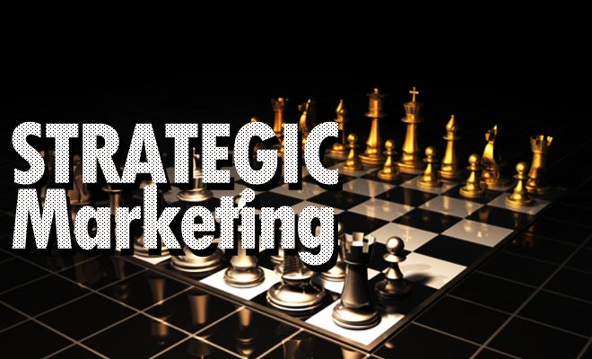
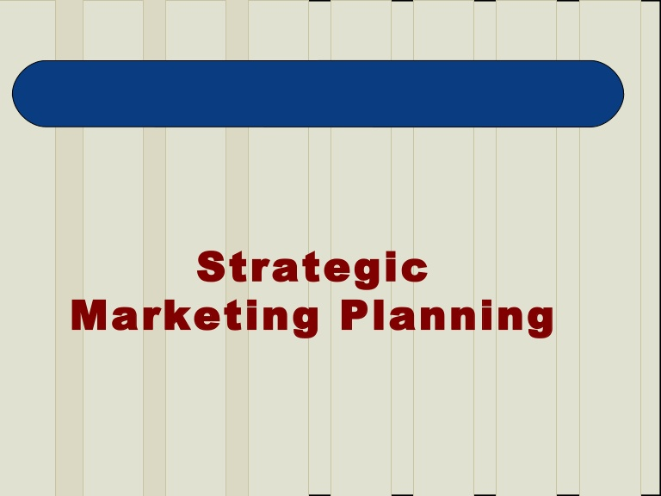
Strategic Marketing Planning

Slide 2
What is Strategic Planning?
It is the managerial process that helps to develop a strategic and viable fit between the firm’s objectives, skills, resources with the market opportunities available.
It helps the firm deliver its targeted profits and growth through its businesses and products.

Slide 3
How To Go About It?
Defining The Corporate Mission
Establishing SBU’S
Allocating Resources For SBU’S
Planning For New Business

Slide 4

Corporate Mission
This seeks to embody the entire goals of the organization and the objective of its existence.
It seeks to provide a sense of purpose, direction and opportunity

Slide 5
5 Questions That The Firm Must Ask Itself
What is our business?
Who is our customer?
What does our customer need?
What will our business be?
What should our business be?

Slide 6

Marketing Myopia
Industry is a customer satisfying process not a goods producing process.
It is important therefore how you redefine your business.
Notes:
Movies – entertainment
Cars – transportation
Cosmetics - hope

Slide 7

Good Mission Statements Have Three Characteristics
They focus on a limited number of goals
It stresses the major values and policies the firm desires
It defines the major competitive scope of operation
Notes:
Scope – industry, product and applications,competence,market segment,vertical,geographical

Slide 8

SBU
It is a company within a company
The business is differentiated from the rest of the company
It has its own set of competitors
It is a separate profit centre

Slide 9
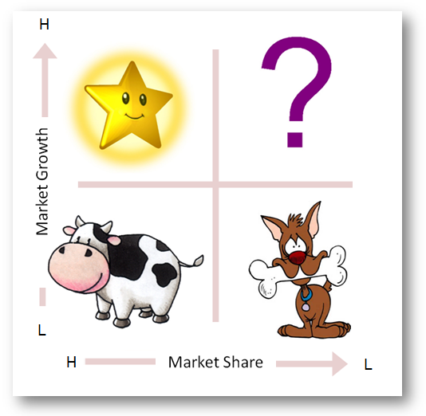
The BCG Matrix

Slide 10
SBU Strategies
SBU Strategies
Build
Hold
Harvest
Divest

Slide 11
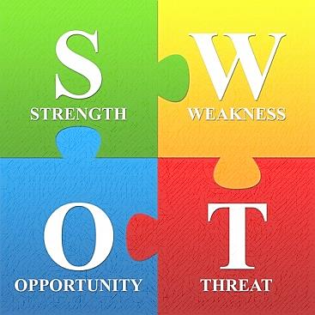
SWOT Analysis

Slide 12
The GE Model
Weak
Medium
Strong
Mkt Attractiveness
Strong
Medium
Weak
Business Strength

Slide 13
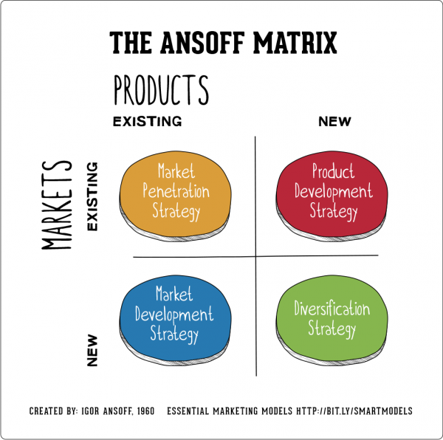
Ansoff’s Product-Market Grid

Slide 14
The Planning Process
Analysing Market Opportunities
Developing Marketing Strategies
Planning Marketing Programs
Managing The Marketing Effort

Slide 15
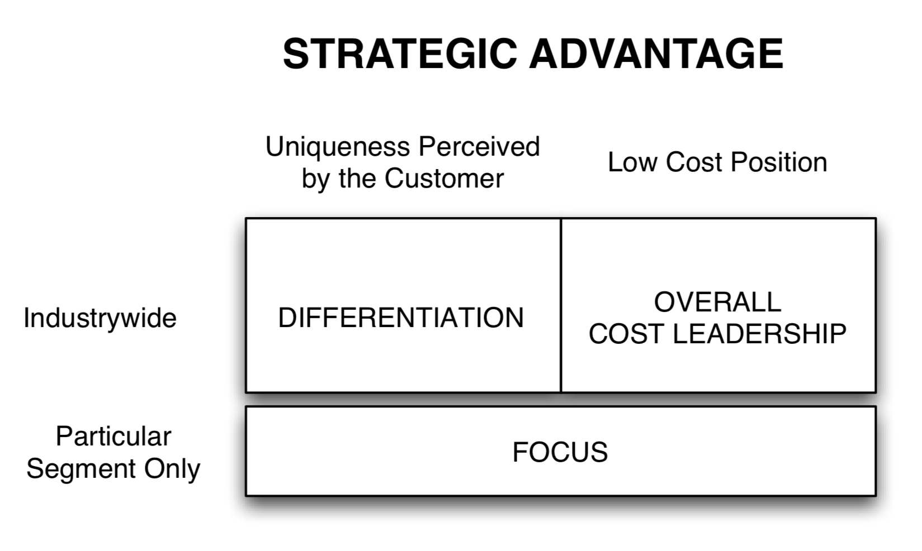
Porter’s Generic Strategies

Slide 16
Marketing Control
Annual Plan Control
Profitability Control
Strategic Control

