Slide 1

Targeting & Segmentation

Slide 2

Target Marketing
Identifying those particular groups of customers which your product/service is capable of meeting their requirements (needs) most.
Each of these groups constitute a market segment
Selecting one or more segments to enter
Establishing and communicating the product’s key distinctive benefits in that market

Slide 3

Market Segment
A large identifiable group within a market with similar wants, purchasing power, geographical locations, buying attitudes

Slide 4
Niche Marketing
What is an attractive niche ?
A distinct set of needs
A premium can be charged
Not likely to attract competition
Gains certain economies through specialisation
Sufficient size, profit and growth potential

Slide 5

Local Marketing
When the marketing mix is altered to suit the local conditions
Eg. Giving a higher/ lower discount than what’s prevailing in the rest of the markets or implementing a different promotion scheme

Slide 6

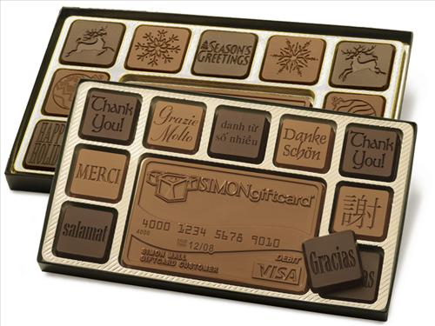
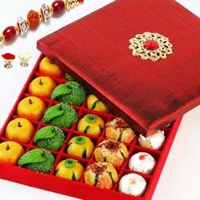
Individualised Marketing
When the firm deals with each customer on a one – to – one basis
When products are customized for the customer

Slide 7
Bases for Segmentation
Geographic
Territory Demarcations
Demographic
Age, Family Size, Sex, Income, Education, Religion, Etc.
Psychographic
Lifestyle, Personality, Values
Behavioral
Knowledge, Attitude, Usage

Slide 8
Behavioral Variables
Occasions
Birthdays, Lunchtime, Vacations
Benefits
eg.Travel – Business, Vacation, Educational
User status
Non Users, Ex users, First time Users, Regular Users, Potential Users
Usage rate
Light, Medium, Heavy

Slide 9
Behavioral Variables (Contd.)
Loyalty status
Diehards, Shifters, Switchers
Buyer Readiness
Unaware – Aware – Informed – Interested – Desire – Intention to Buy
Attitude
Enthusiastic, Positive, Indifferent, Negative, Hostile

Slide 10
Criteria for segmentation
Measurable
Substantial
Accessible
Differentiable
Actionable

Slide 11
Market Targeting
Single Segment Concentration
Selective Specialisation
Product Specialisation
Market Specialisation
Full Market Coverage: Undifferentiated marketing , Differentiated marketing

Slide 12

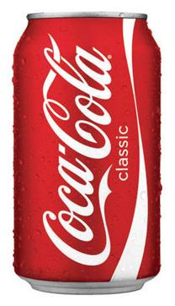
Undifferentiated Marketing
Single product addressing all segments with a single marketing program.
Mass production is possible giving scale economies
Pushes price downwards enabling to attract price sensitive segments

Slide 13
Differentiated Marketing
A separate market offering for every segment
Marketing programs for every segment could be different
Pushes up costs at various levels, necessitating sufficient volumes for viability
Generates inter-segment rivalry

Slide 14









Differentiated Marketing
Notes:
http://www.centuryply.com/brand/listing/plywood/centuryply-architect-plywood
http://www.centuryply.com/brand/listing/plywood/kleanwud
http://www.centuryply.com/brand/listing/plywood/centuryply-club-prime-plywood
http://www.centuryply.com/brand/listing/plywood/centuryply-club-prime-plywood

